Slide 1

Query Processing

Slide 2
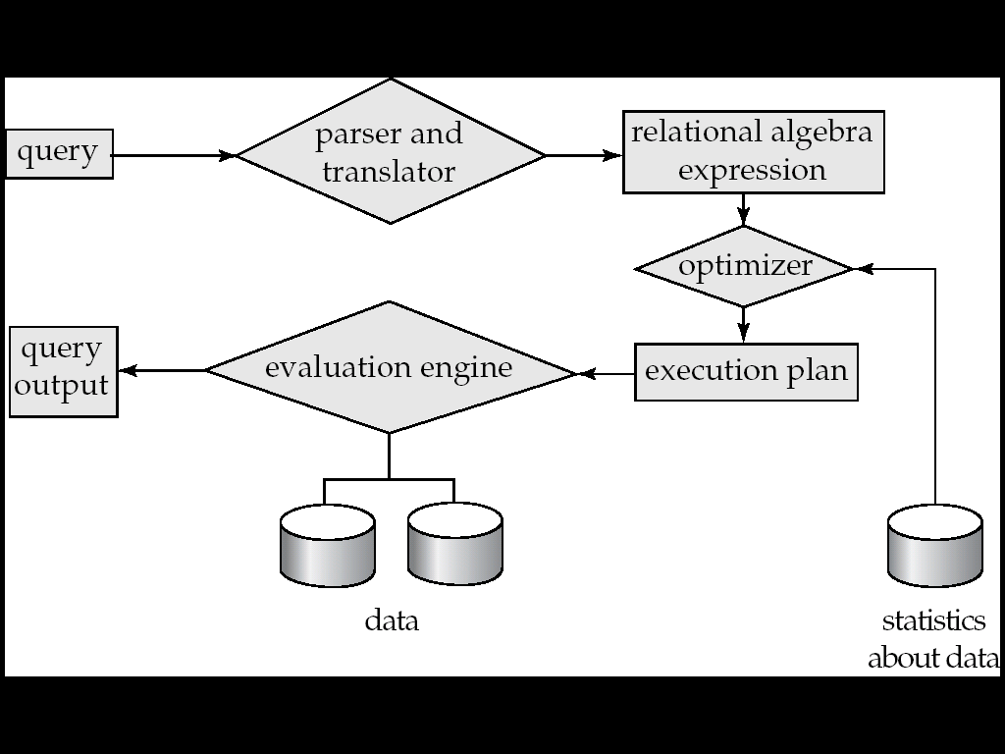
Basic Steps in Query Processing
1. Parsing and translation
2. Optimization
3. Evaluation

Slide 3
Basic Steps in Query Processing (Cont.)
Parsing and translation
  translate the query into its internal form. This is then translated into relational algebra.
  Parser checks syntax, verifies relations
Evaluation
  The query-execution engine takes a query-evaluation plan, executes that plan, and returns the answers to the query.

Slide 4
Basic Steps in Query Processing : Optimization
A relational algebra expression may have many equivalent expressions
  E.g., σ_{balance<2500}(∏_{balance}(account)) is equivalent to
  ∏_{balance}(σ_{balance<2500}(account))
Each relational algebra operation can be evaluated using one of several different algorithms
  Correspondingly, a relational-algebra expression can be evaluated in many ways.
Detailed evaluation strategy is called an evaluation-plan.
  E.g., can use an index on balance to find accounts with balance < 2500,
  or can perform complete relation scan and discard accounts with balance ≥ 2500

Slide 5
Basic Steps: Optimization (Cont.)
Query Optimization: Amongst all equivalent evaluation plans choose the one with lowest cost.
  Cost is estimated using statistical information from the
  database catalog
    e.g. number of tuples in each relation, size of tuples, etc.
  How to measure query costs.
  Algorithms for evaluating relational algebra operations.
  How to combine algorithms for individual operations in order to evaluate a complete expression.
  Next we will study how to optimize queries, that is, how to find an evaluation plan with lowest estimated cost.

Slide 6
Measures of Query Cost
Cost is generally measured as total elapsed time for answering query
  Many factors contribute to time cost
  disk accesses, CPU, or even network communication
Typically disk access is the predominant cost, and is also relatively easy to estimate. Measured by taking into account
  Number of seeks * average-seek-cost
  Number of blocks read * average-block-read-cost
  Number of blocks written * average-block-write-cost
    Cost to write a block is greater than cost to read a block
      data is read back after being written to ensure that the write was successful

Slide 7
Measures of Query Cost (Cont.)
For simplicity we just use the number of block transfers from disk and the number of seeks as the cost measures
  t_{T} – time to transfer one block
  t_{S} – time for one seek
  Cost for b block transfers plus S seeks
  b * t_{T} + S * t_{S}

Slide 8
Selection Operation
File scan – search algorithms that locate and retrieve records that fulfill a selection condition.
A1 (linear search). Scan each file block and test all records to see whether they satisfy the selection condition.
  Cost estimate = br block transfers + 1 seek [an initial seek is required to access the first block of the file]
A2 (binary search). Applicable if selection is an equality comparison on the attribute on which file is ordered.
  Assume that the blocks of a relation are stored contiguously
Index scan – search algorithms that use an index
  selection condition must be on search-key of index.
A3 (primary index on candidate key, equality). Retrieve a single record that satisfies the corresponding equality condition.

Slide 9
Query Optimization

Slide 10
Query Optimization
Introduction
Transformation of Relational Expressions
Catalog Information for Cost Estimation
Statistical Information for Cost Estimation
Cost-based optimization
Dynamic Programming for Choosing Evaluation Plans
Materialized views

Slide 11
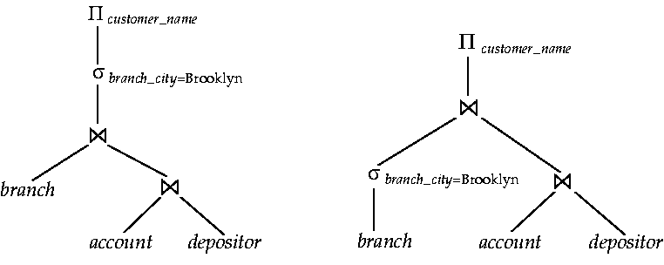
Introduction
Alternative ways of evaluating a given query
  Equivalent expressions
  Different algorithms for each operation

Slide 12
Using Heuristics in Query Optimization
Process for heuristics optimization
The parser of a high-level query generates an initial internal representation;
Apply heuristics rules to optimize the internal representation.
A query execution plan is generated to execute groups of operations based on the access paths available on the files involved in the query.
The main heuristic is to apply first the operations that reduce the size of intermediate results.
E.g., Apply SELECT and PROJECT operations before applying the JOIN or other binary operations.

Slide 13
Using Heuristics in Query Optimization
Query tree: a tree data structure that corresponds to a relational algebra expression. It represents the input relations of the query as leaf nodes of the tree, and represents the relational algebra operations as internal nodes.
An execution of the query tree consists of executing an internal node operation whenever its operands are available and then replacing that internal node by the relation that results from executing the operation.
Query graph: a graph data structure that corresponds to a relational calculus expression. It does not indicate an order on which operations to perform first. There is only a single graph corresponding to each query.

Slide 14
Using Heuristics in Query Optimization
Example:
For every project located in ‘Stafford’, retrieve the project number, the controlling department number and the department manager’s last name, address and Birthdate.
Relation algebra:
πPNUMBER, DNUM, LNAME, ADDRESS, BDATE (((σ_{PLOCATION=‘STAFFORD’}(PROJECT))
_{DNUM=DNUMBER} (DEPARTMENT)) _{MGRSSN=SSN} (EMPLOYEE))
SQL query:
Q2: SELECT P.NUMBER,P.DNUM,E.LNAME, E.ADDRESS, E.BDATE
FROM PROJECT AS P,DEPARTMENT AS D, EMPLOYEE AS E
WHERE P.DNUM=D.DNUMBER AND D.MGRSSN=E.SSN AND
P.PLOCATION=‘STAFFORD’;

Slide 15
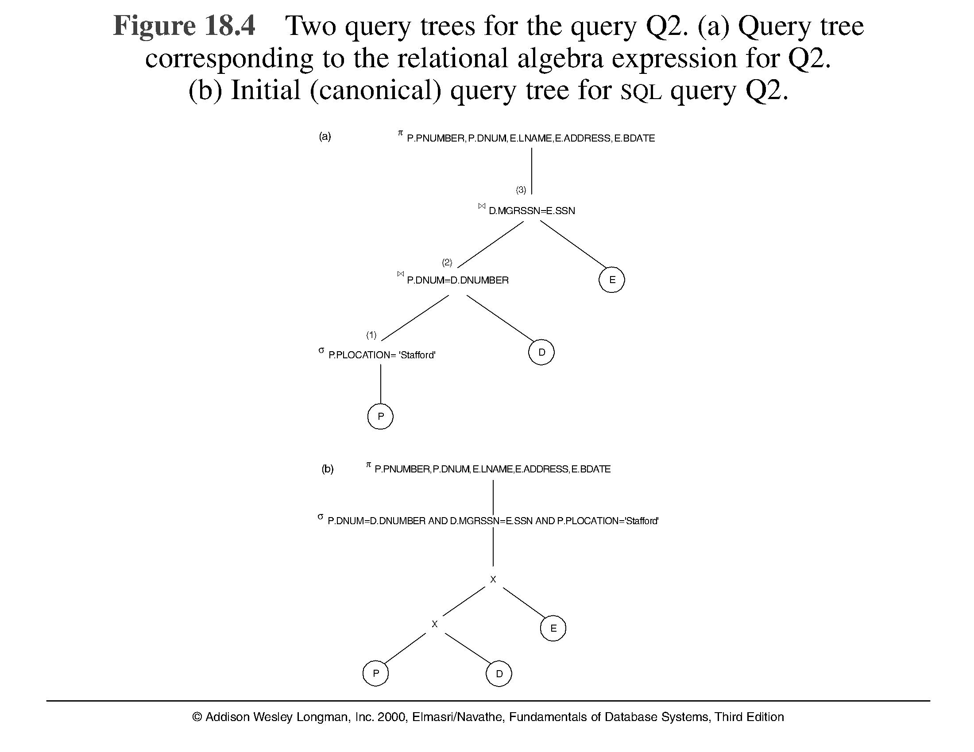
Using Heuristics in Query Optimization

Slide 16
Using Heuristics in Query Optimization
Heuristic Optimization of Query Trees:
The same query could correspond to many different relational algebra expressions — and hence many different query trees.
The task of heuristic optimization of query trees is to find a final query tree that is efficient to execute.
Example:
Q: SELECT LNAME
FROM EMPLOYEE, WORKS_ON, PROJECT
WHERE PNAME = ‘AQUARIUS’ AND PNMUBER=PNO
AND ESSN=SSN AND BDATE > ‘1957-12-31’;

Slide 17
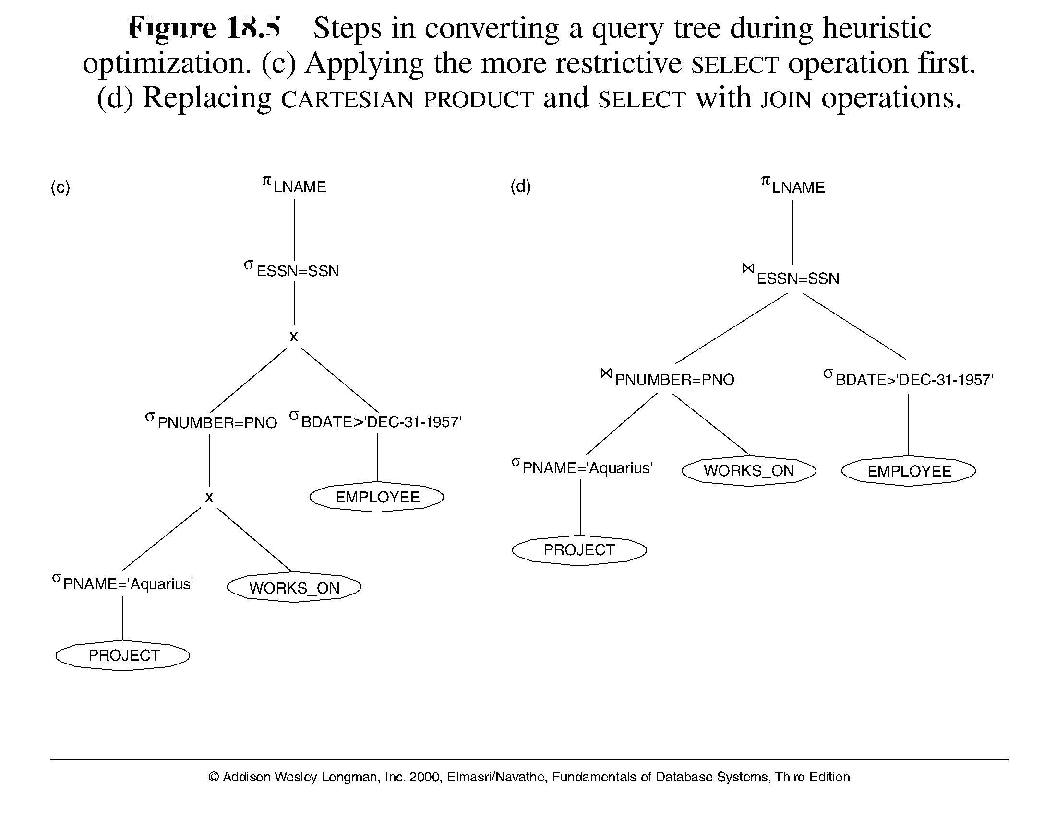
Using Heuristics in Query Optimization

Slide 18
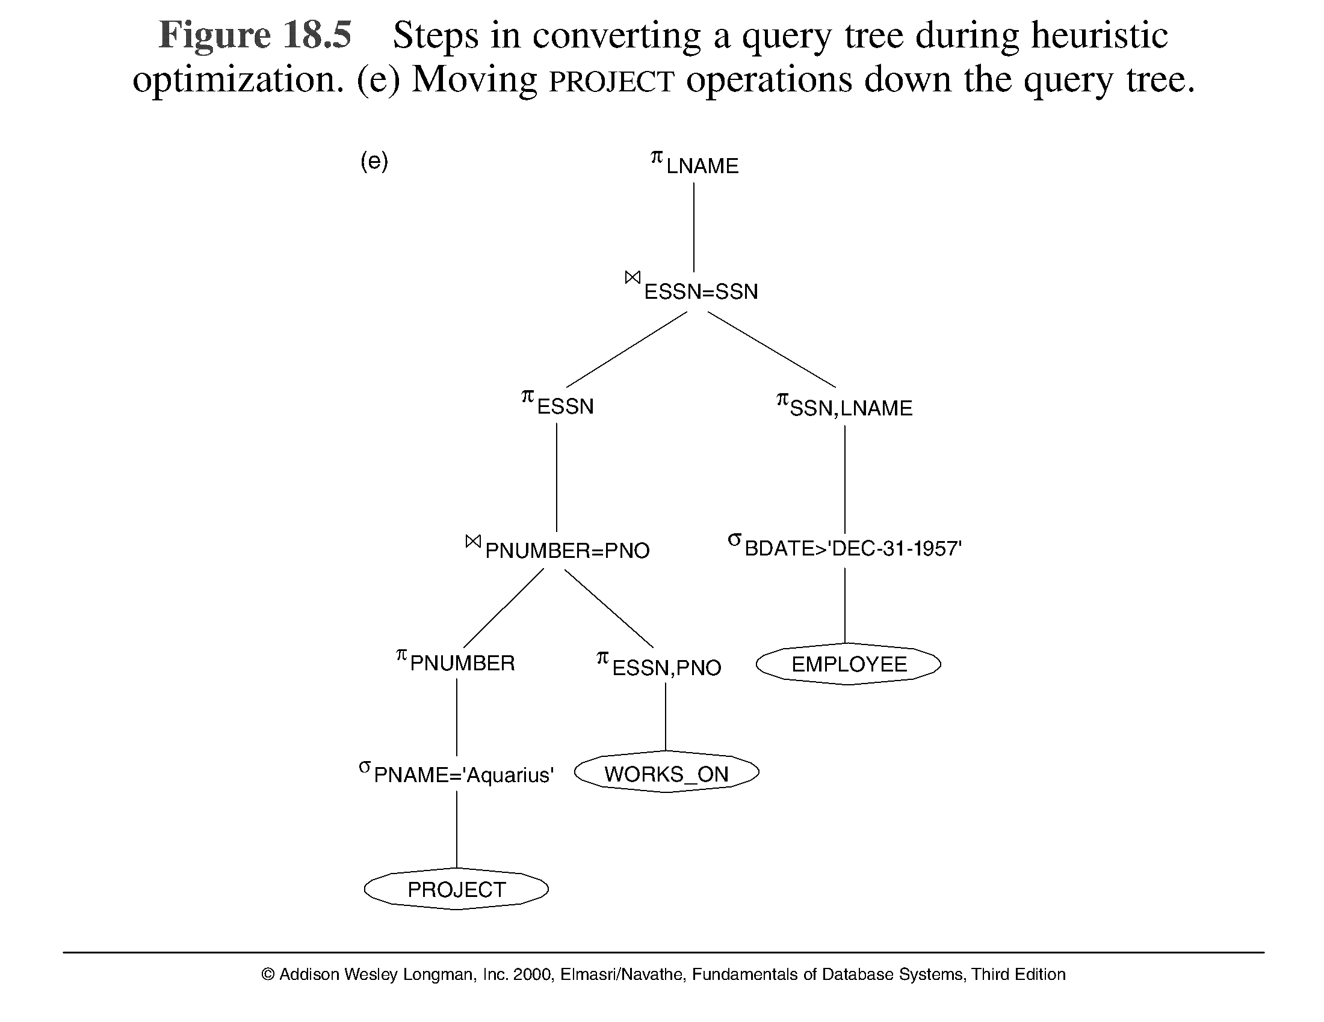
Using Heuristics in Query Optimization

Slide 19
Using Heuristics in Query Optimization
Summary of Heuristics for Algebraic Optimization:
The main heuristic is to apply first the operations that reduce the size of intermediate results.
Perform select operations as early as possible to reduce the number of tuples and perform project operations as early as possible to reduce the number of attributes. (This is done by moving select and project operations as far down the tree as possible.)
The select and join operations that are most restrictive should be executed before other similar operations. (This is done by reordering the leaf nodes of the tree among themselves and adjusting the rest of the tree appropriately.)

Slide 20
Using Heuristics in Query Optimization
Query Execution Plans
An execution plan for a relational algebra query consists of a combination of the relational algebra query tree and information about the access methods to be used for each relation as well as the methods to be used in computing the relational operators stored in the tree.
Materialized evaluation: the result of an operation is stored as a temporary relation.
Pipelined evaluation: as the result of an operator is produced, it is forwarded to the next operator in sequence.

Slide 21
Heuristic Optimization
Cost-based optimization is expensive, even with dynamic programming.
Systems may use heuristics to reduce the number of choices that must be made in a cost-based fashion.
Heuristic optimization transforms the query-tree by using a set of rules that typically (but not in all cases) improve execution performance:
  Perform selection early (reduces the number of tuples)
  Perform projection early (reduces the number of attributes)
  Perform most restrictive selection and join operations (i.e. with smallest result size) before other similar operations.
  Some systems use only heuristics, others combine heuristics with partial cost-based optimization.

Slide 22
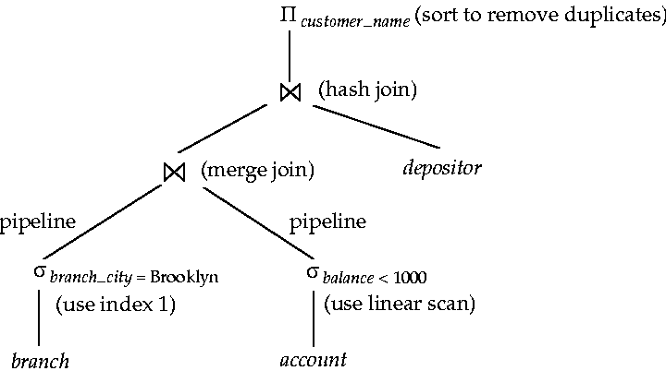
Introduction (Cont.)
An evaluation plan defines exactly what algorithm is used for each operation, and how the execution of the operations is coordinated.

Slide 23
Introduction (Cont.)
Cost difference between evaluation plans for a query can be enormous
  e.g. seconds vs. days in some cases
Steps in cost-based query optimization
  Generate logically equivalent expressions using equivalence rules
  Annotate resultant expressions to get alternative query plans
  Choose the cheapest plan based on estimated cost
Estimation of plan cost based on:
  Statistical information about relations. Examples:
    number of tuples, number of distinct values for an attribute
  Statistics estimation for intermediate results
    to compute cost of complex expressions
  Cost formula for algorithms, computed using statistics

